Slide 1


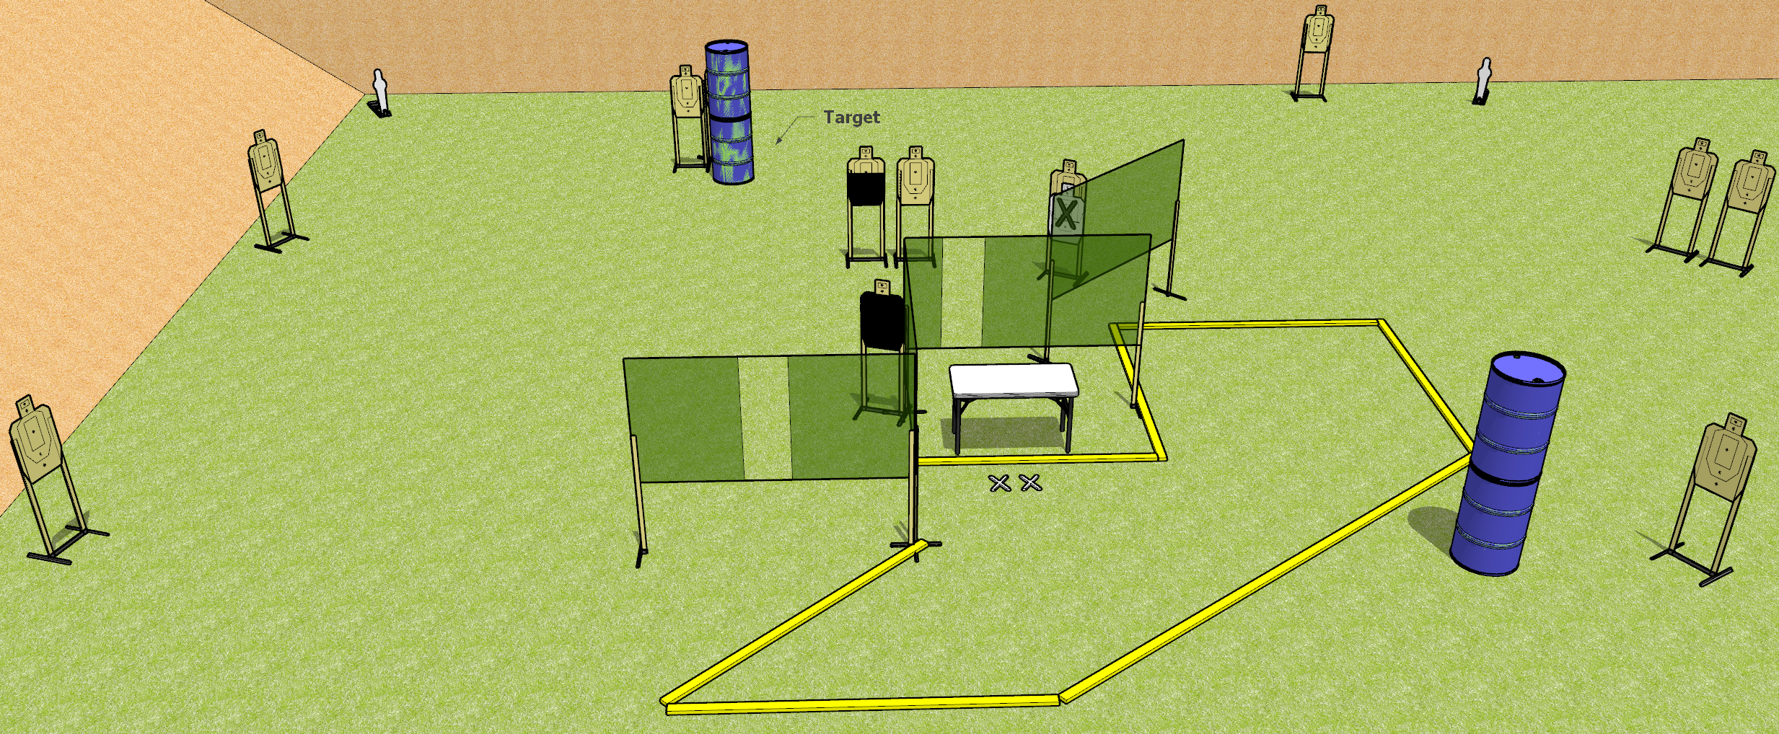
 | Dothan Gun Club – USPSA Match All on the Table Course Designer : Drew Coleman
26 rounds 12 USPSA Targets 2 USPSA mini poppers
12 target stands 6 wall feet 1 table

Slide 2
All on the Table
Written Stage Briefing
All on the table is a 26 round, 130 point, Comstock field course. There are 12 USPSA targets and 2 USPSA mini poppers. The best 2 hits on paper will score, and steel must fall to score. The start signal is audible.
Start position is both feet on X’s, fingers touching ears. Firearm is unloaded on table trigger guard on mark, lying unsupported. All magazines to be used during the stage are on table.
On start signal, engage targets as they become available from within the shooting area.

